Slide 1
Electronics Systems (938II)
Lecture 0 – Teacher intro and contacts, course intro

Slide 2
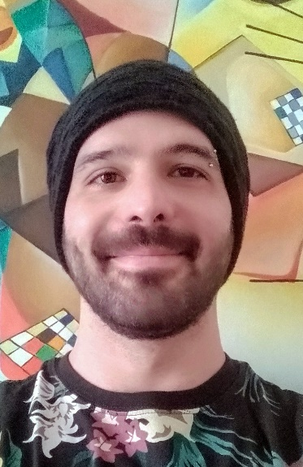
My contacts and reception info
Luca Crocetti
Assistant Professor at the Department of Information Engineering (University of Pisa)
Contacts
E-mail luca.crocetti@unipi.it
Teams a026770@unipi.it
Website https://people.unipi.it/luca_crocetti/en/

Slide 3
My contacts and reception info
Luca Crocetti
Student reception:
Booking via e-mail (or Teams)
Remote reception (via Teams) – Mainly
Physical reception – Possible, but to be scheduled a few days in advance

Slide 4
Course intro
Exam:
Oral (only)
About 1h (~30’ + ~30’)
Electronics Systems: → ~30’
Me → ~ 15’
Prof. Baronti → ~ 15’
Telecommunication Technologies → ~30’
Prof. Luise → ~ 15’
Prof. Bacci → ~ 15’

Slide 5
Course intro
Course content (overview) – Module: Electronics Systems
A journey to understand the main characteristics and components of modern electronic digital systems

Slide 6
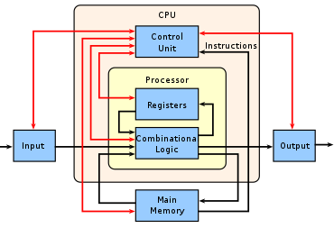
Course intro
Course content (overview) – Module: Electronics Systems

Slide 7
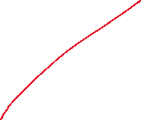

Course intro
Course content (overview) – Module: Electronics Systems

Slide 8
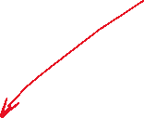
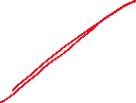

Course intro
Course content (overview) – Module: Electronics Systems

Slide 9


Course intro
Course content (overview) – Module: Electronics Systems

Slide 10
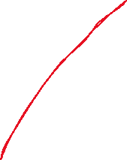

Course intro
Course content (overview) – Module: Electronics Systems

Slide 11




Course intro
Course content (overview) – Module: Electronics Systems

Slide 12
Course intro
Course content (overview) – Module: Electronics Systems
Basic principles: CMOS technology and digital data representation (F. Baronti)
Combinational and Sequential logic elements (L. Crocetti)
Finite State Machine (L. Crocetti)
Memories (L. Crocetti)
Programmable Logic Devices (L. Crocetti)
ADC, DAC (F. Baronti)
CPU Organisation (F. Baronti)

Slide 13
Course intro
Course content (overview) – Module: Electronics Systems
Basic principles: CMOS technology and digital data representation (F. Baronti)
Combinational and Sequential logic elements (L. Crocetti)
Finite State Machine (L. Crocetti)
Memories (L. Crocetti)
Programmable Logic Devices (L. Crocetti)
ADC, DAC (F. Baronti)
CPU Organisation (F. Baronti)

